Slide 1
New Communities Partnership
Legal aid board annual conference
September 2016
Daniela jurj
national coordinator
Migrant Family Support Service

Slide 2
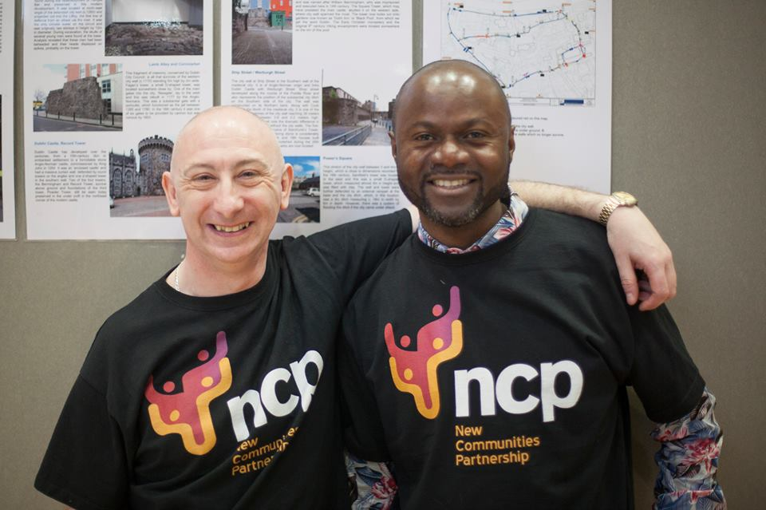
New communities partnership Empowering and representing ethnic minorities and their organizations in Ireland
The only migrant led organization in Ireland
National organization
165 migrant led community groups
70 different nationalities
offices in Dublin and Cork
outreach services
Work in partnership with
State agencies

Slide 3
NCP services 2015- 2016
Over 9200 drop ins to the NCP services in 2015
Citizenship Application Support Service (CASS)- over 13.000 individuals supported
English Language and Homework Support Service- 3 schools, 60 students of 10 nationalities, 15 volunteer teachers
Social Inclusion and Community Activation Program (SICAP)- 116 individuals and 37 groups supported
Cultural Support Ireland (CSI)- new service launched
Migrant Family Support Service (MFSS)
over 3500 calls (200% increase from 2014)
133 families of 26 nationalities sought support
80% of referrals come from Tusla- Child and Family Agency

Slide 4
New communities partnership established in 2003

Slide 5
Ncp migrant family support service
Funded by TUSLA- Child and Family Agency
Independent service
Grass root work
Hands on service
HOLISTIC APPROACH
Focus on clients and their experiences

Slide 6
MFSS offers
Intervention
Information and support for migrant families with children in care or currently experiencing child protection interventions
2. Cultural support for front line professionals
Prevention
3. Awareness raising about Child Protection practices in Ireland for migrant, religious and community leaders and migrant NGOs:
Training
Information sessions
Develop and distribute information literature

Slide 9
Reasons for migrant children coming into care
Lone parents struggling after years of Direct Provision
Parental mental health or cognitive needs not being met
Domestic Violence
Children being left unsupervised
Physical punishment
Lack of understanding of Irish child protection legislation

Slide 10
CONCERNS, observations AND Issues arising based on MFSS client’s experiences
Disproportionate number of migrant children coming into care
Different understandings of parenting and family dynamics in various cultures
Parents not aware of certain parenting practices not acceptable anymore in Ireland. Children learn more about CP in school than what their parents know. (ALL parents)
Lack of cultural awareness training for front line staff and foster carers
Language barriers
Confusing system- institutions, services, who does what and WHY? WHAT’S THE PLAN?
Preconceptions about certain professionals- “You don’t find a SW, a SW finds you”. “LAB solicitors work hand in hand with the SW, sure they are all Government” = lack of trust
Fear and distrust of parents of institutions in their own countries of origin- ie Somali ladies and Gardai
Preconceived notions/ stereotypes of parents from particular cultures

Slide 11
CONCERNS, observations AND Issues arising based on MFSS client’s experiences
No copies of forms, care plans, reports, assessments given to parents
Courts- In Camera Ruling vs packed corridors
Statements interpreted out of context
Discretion used in decision making
Waiting for days for phone calls to be returned back. Very little happening between Court dates.
Lack of knowledge about complaint mechanisms available
View of family reunification
Access vs Working on mending/ improving the child/ parent relationship
Grey areas - understanding “The best interest of the child” , what constitutes “Good enough parenting”, age of children to be left unattended
The impact of the intervention on the front line staff- interventions in profound crisis in some families. Who cares for the carers?

Slide 12
Challenges for the system
Balancing the constitutional rights of the family with the rights of the child.
Court is seen as adversarial
Maintaining a holistic view of the family unit
TIME

Slide 13
Lab annual conference 2016 “facing family difficulties- the Experience”
“You are so kind and respectful. You really changed my situation. I did not know so much before and I was making bad choices as a parent. But I wasn’t all wrong . I just didn’t know what those people meant (SW, GAL and Services). Now I know and I make different choices. I keep praying for you and all your offices so that God continues to give you love and kindness and wisdom to guide others. This is all that I can give you to repay your support. You have been very, very helpful. You are all so down to earth.”
Parent, MFSS Client

Slide 14
Why listen to the parents?
“Only when parents develop an honest relationship with their social workers can they contribute effectively to planning the care and hence the well-being of their children.”
(Sinclair and Grimshaw 1997)

Slide 15
What silences the parents involved in child care cases?
Parents voices are not always being heard because of:
Lack of TRUST in the professionals
Intimidating number of professionals attending a Child Care Case Court hearings
Immigration status
Shame is silencing. Social stigma of having a child in care.
Isolation within own communities
Lack of self confidence. Not understanding the terminology used by professionals.
Fear of Courts
Lack of English and illiteracy
Bereavement
In most cases, the best and only support a parent has is their LAB Solicitor.

Slide 16
How to improve the parent’s understanding of what is going on
Legal representation is a must.
NCP advocates as cultural brokers.
Understanding processes and making clear and informed choices. Greater transparency is needed.
Summons explained to the parent before being sent.
Reports available before Court, explained to parents, amended if needed.
Core professionals meetings before Court- creative solutions reached through mediation.
Private consultation rooms when in Court.
Parents and professionals to keep each other informed of the small details, in order to build a trustful relationship.

Slide 17
How to improve the parent’s understanding of what is going on
Leaflets explaining procedures, rights and supports available- ideally in a variety of languages
Use pictures, videos, examples
When using interpreting services, check credentials of the interpreter
People don’t always get it right, but it’s important they try. A little word of encouragement goes a long way.
Being mindful of own attitude and values. What are your own cultural lenses?
Communicate in plain English. Make no presumptions.
Child protection training

Slide 18
Please remember:
MESSAGE SENT IS NOT ALWAYS MESSAGE RECEIVED!

Slide 19
Language is a big challenge
Affectionate cursing
Sorry
Apologies
Grooming
Bold

Slide 20
Practitioners vs parents perceptions of child care cases
Some statements
“I never knew I was doing something wrong!”
“They need to listen to what we have to say!”
“They just don’t get it, do they??”
“Tell me what I need to do, not only what NOT to do!”
“You’ve turned my hopelessness into hopefulness!”
“Nothing we do is ever good enough with them.”
“What’s the story with the hair care?”
“Meeting a child’s needs? Aaaah sure, it’s the Maslow pyramid!”

Slide 21
How to improve the parent’s understanding of what is going on
NCP uniqueness in service delivery:
Proved track record (2003- present) of working with:
- State agencies
- Migrant communities in Ireland
2. Constant connection and relationship with migrant communities in Ireland. Practical, hands on, grass-root work.
3. NCP’s ethnic and minority diverse team
TRUST:
Clients trust NCP as they can see a connection
Tusla- Child and Family Agency identifying NCP as the link to fill the cultural gap

Slide 22
You’re not in this alone
“The MFSS has been an invaluable resource in the local community that serves the families our Agency works with. The staff are very accommodating and professional in how they deliver the service. Families and professionals alike really benefit from the service and it has filled a huge gap in community service provision that has been long awaited.”
Social Worker- Tusla Child and Family Agency

Slide 23
How to improve the parent’s understanding of what is going on
Invest TIME and
TALK
Talk TO parents, rather than AT parents.

Slide 24
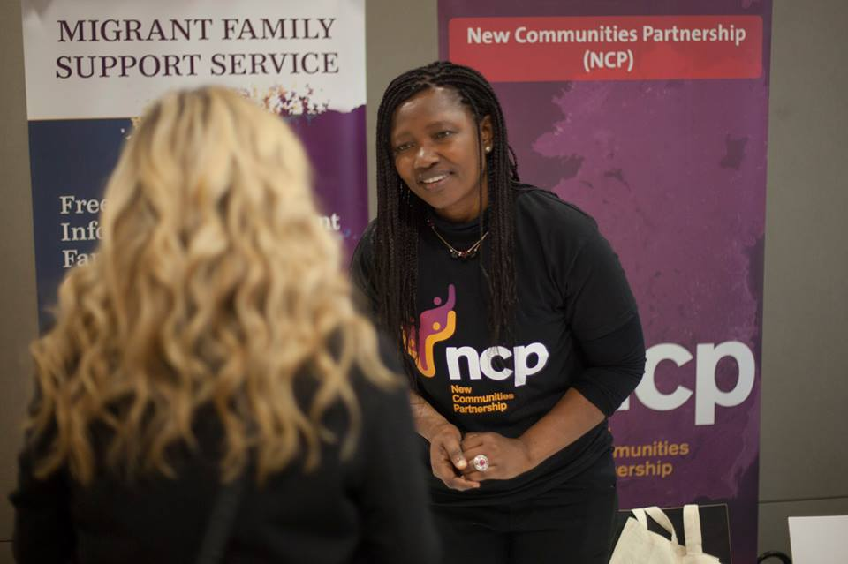
Thank you !
Daniela Jurj
MFSS National Coordinator
New Communities Partnership
53, Upper Dorset St, Dublin 1
Phone number: 01 872 7842
Contact: daniela@newcommunities.ie
Web: www.newcommunities.ie
NCP, 53 Upper Dorset St Dublin 1, telephone 01 872 7842

