Slide 1
The Professional Under Pressure: Why your Resilience Matters
Dr Carole Pemberton
Coaching to Solutions

Slide 2
VUCA

Slide 3
We Live in a VUCA World
Resilience
Volatile
Uncertain
Complex
Ambiguous

Slide 4
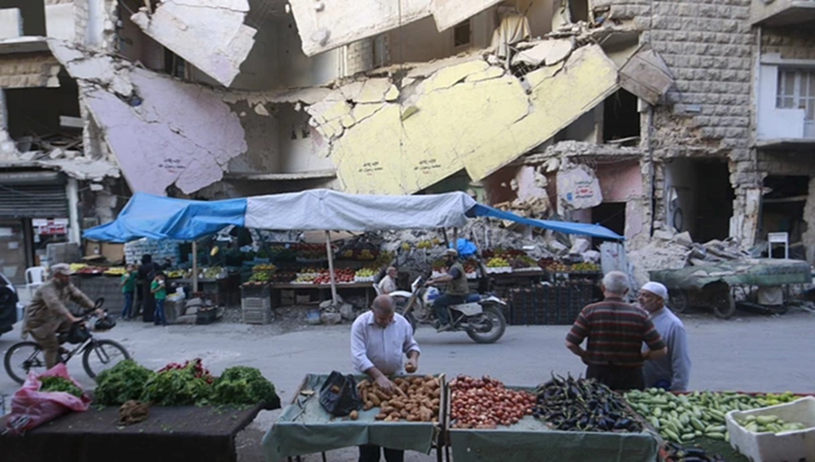
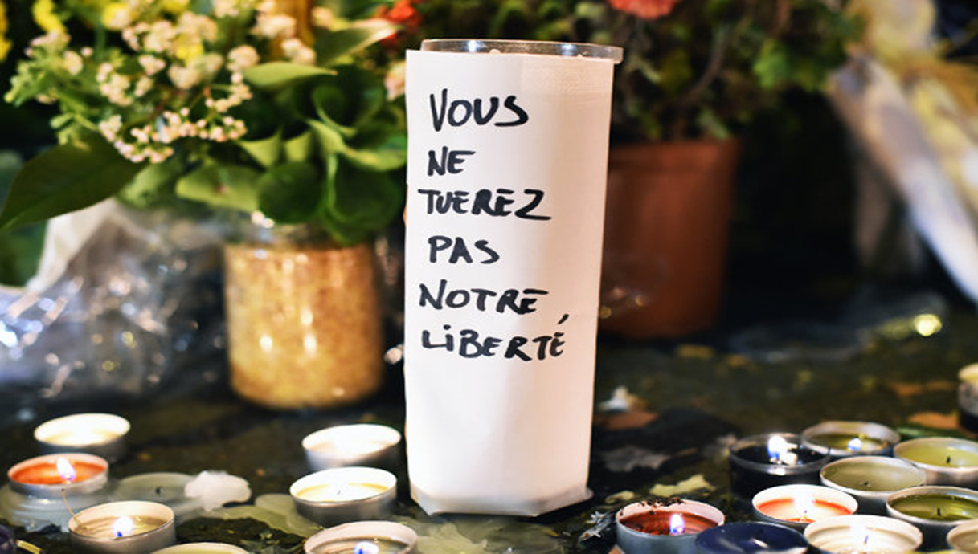
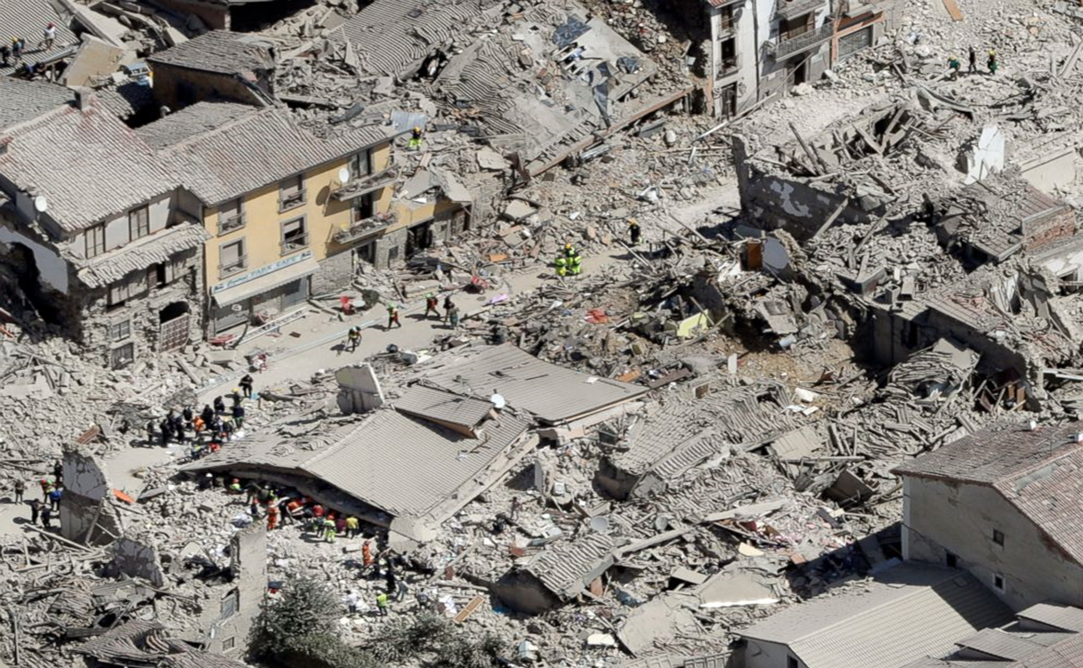
Resilience in 4 Images

Slide 5
Resilience in Action
Andy Winter: CEO Brighton Housing Trust
Combatting homelessness Creating opportunity Promoting change

Slide 6
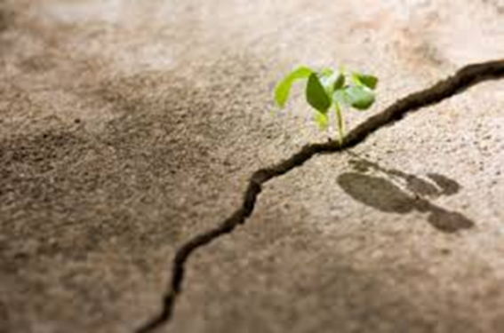
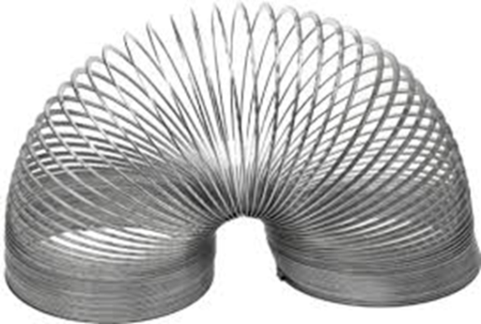
Resilience: A Work Focussed Definition
The ability to remain flexible in our thoughts, feelings and behaviours when faced by a life disruption or extended periods of pressure, so that we emerge from difficulty stronger, wiser and more able. .
Pemberton: Resilience (McGraw Hill 2015)
21st century wisdom for people with busy lives

Slide 7
What Do We Know About Resilience?
Genetics
Childhood protectors
Learning from adversity

Slide 8
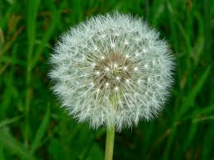
The Resilience Gene?
Cortisol receptor gene NR3CI
Orchid
Dandelion
Ellis and Boyce
Albert et al 2015
Duke University

Slide 9
The Resilience Fulcrum
Neglect
Mental illness
Poverty
Positive
Influences
Inconsistent
parenting
Genes
Negative
Influences
Secure attachment
Intelligence
Harvard Center for Child Development
Support
Safety
Purpose
Notes:
Negative qualities
Studies of children who are neglected in their early developmental stages show that their ability to process events cognitively is impaired.
Children who do not have strong attachment to a parental figure, where the parent figure is distracted or inconsistent the child will be clinging when she is there and inconsolable when she leaves, but also when she returns. In adult life it produces adults who lack confidence and are more timid. A child who is neglected will become indifferent to others, may show a recklessness in their behaviour.
In contrast a child who experiences secure attachment who can trust on their parent’s behaviour that their needs will be met, learns how to self sooth, how to go out into the world and take risk with a sense that they can manage it.
The findings from a groundmaking study of Hawaiian children was that those who did best had a figure in their loves who gave them support, they had personalities which attracted to support and they created a sense of purpose for themselves.
A more recent study of children in war torn Gaza showed that those who were more resilient had a problem solving approach to difficulties rather than having coping strategies which were avoiding the reality of their situation e.g. drug taking.

Slide 10
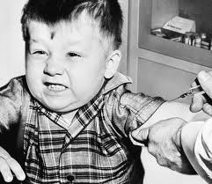
Resilience is Learned (Mostly)
Adversity as
Innoculation
Professor Michael Rutter

Slide 11
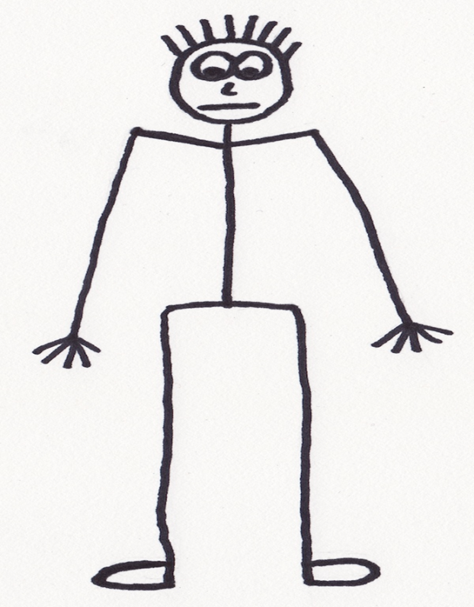
What changes when your resilience is getting stretched?
Notes:
Ask to consider how they know their resilience is getting stretched.
Just as my CS client noticed that their sleep patterns were changing, and he did not want to spend social time with friends and colleagues, we each have markers that tell us that our resilience is leaving us.
This can a wide range of things encompass a wide range of marker e.g. our eating and drinking patterns, our mood, our mental functioning, our effectiveness.
Stop and for the next few minutes identify with a partner the things that tell you that your resilience is going.
Collect examples and then pick up that whilst we notice the signs a default position is often ‘keep buggering on’.
However, having looked at the resilience of leaders who have led their organisations through times of crisis and change, they have strategies for resourcing themselves.
The first of these is focus.

Slide 12
What Makes Up Resilience?
Notes:
Resilience is an inference based on observation that some people have a better outcome than others when faced by a comparable level of adversity. Michael Rutter.
Resilience is an outcome. What are the contributing variables.

Slide 13
Your Resilience Profile
X
True
X
X
X
X
X
X
X
X
X
X
X
X
Energy
focus
Face
Reality
Managing
Thoughts
Grit
Untrue
Emotional
Control
Proactivity
Balance
Support
Reflection
Purpose
Confidence
Flexibility
Optimism

Slide 14
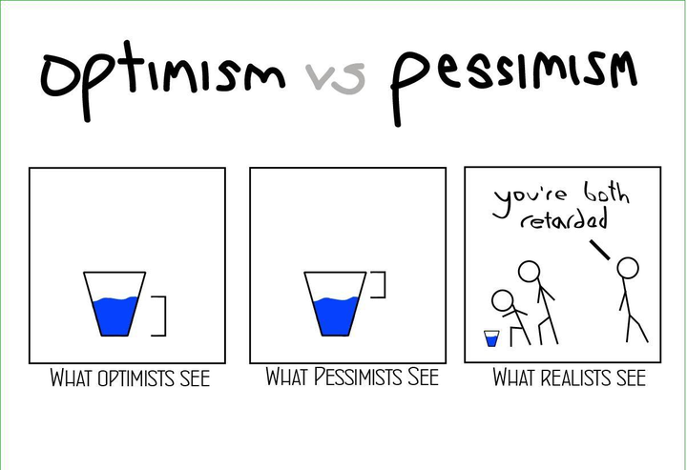
Optimism
I am optimistic about my work.

Slide 15
Flexibility
I don’t find it difficult to change my approach when something isn’t working or is no longer wanted.

Slide 16
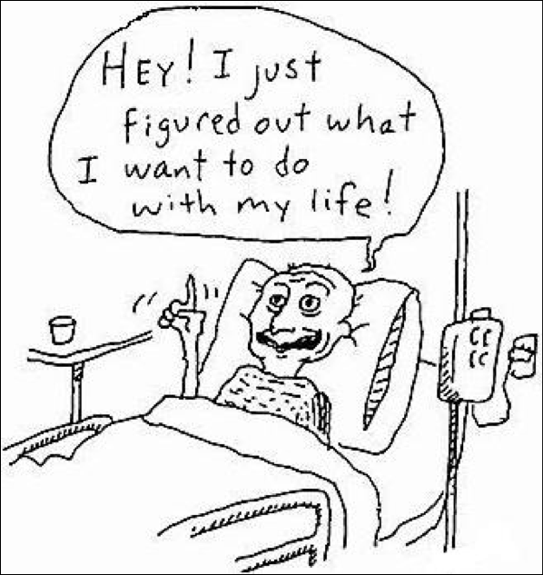
Purpose
I know what I want from my career and why.

Slide 17
Support
When I am struggling with something I talk to people who can help me.

Slide 18
Emotional Control
I can control my emotions even when I am feeling pressured.

Slide 19
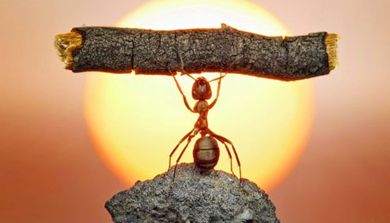
Confidence
My confidence is strong regardless of the immediate difficulties.

Slide 20
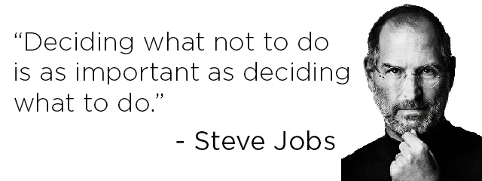
Focus
I can focus my energies on the right things even when under pressure.

Slide 21
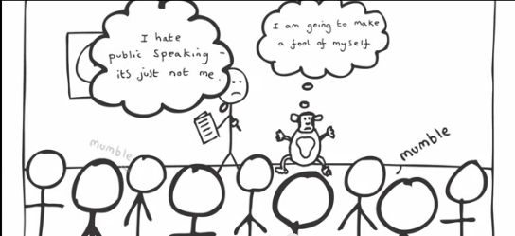
Managing Thoughts
I am able to challenge my thoughts when they undermine me.

Slide 22
Proactivity
I am decisive and don’t procrastinate.

Slide 23
Facing Reality
I can face reality even when it is uncomfortable.

Slide 24
Balance
I keep a sense of balance in my life even when I am dealing with tough stuff.

Slide 25
Grit
I stick at things once I commit to them.

Slide 26
Reflection
I take time out to reflect on what I am doing even when I have no time.

Slide 27
Learning from Leaders
Eat, Sleep, Move
Physical Energy
Mental Energy
Emotional Energy
Energy of Purpose
Energy Focus
vs Goal
Reflection time
Thinking supporters
Why this
matters to me
Notice what is OK
I am not my job
Notes:
If time ask to stop and consider which sources of their resilience energy do they take care of. What do they not give attention to.
Research evidence from the US military that came out only a couple of weeks ago showed that soldiers who are not sleeping well are less resilient. They become ill more often, they are more likely to leave, they are less likely to be able to do their jobs on the front line.

Slide 28
Building Resilience
Do One Thing Differently for One Month – and your brain will have rewired to see it as the new normal.

Slide 29
So to Summarise
We are all resilient and unresilient
Genetics vs Childhood and Life
You have an individual template
We need to notice when our resilience is getting frayed
Take care of your physical, emotional, mental and purpose energies.

Slide 30
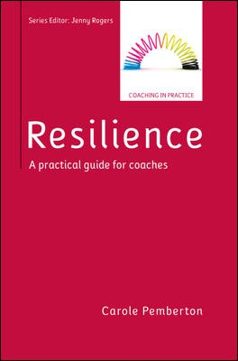
Resources
Look at my website for video clips and blogs www.carolepemberton.co.uk
Resilience: A Practical Guide for Coaches
Lots of tools for working with resilience issues
Contact me: carole.pemberton@coachingtosolutions.com
+44 7710 358176

