Slide 1
Legal Aid Board: Solicitors Panel for Home Mortgage Arrears Scheme; Training Day
Christopher Lehane, Official Assignee

Slide 2
Overview
Law Governing Bankruptcy
Official Assignee in Bankruptcy
Consequences of Bankruptcy
Self Adjudication Process
Family Home
Income Payment Orders
Discharge

Slide 3
LAW GOVERNING BANKRUPTCY IN IRELAND
Bankruptcy Acts 1988 – 2015
Civil Law (Misc. Provisions) Act 2011
Personal Insolvency Act 2012 – Part 4
Courts and Civil Law (Misc Provs) Act 2013 – Part 7
Companies (Misc Provs) Act 2013
Rules of the Superior Courts (Order 76 and Appendix 0) amended by SI 461/13, 600/14
ISI Regs – Accounts (SI 464/13 ); Fees (SI 465/13)
European Union Insolvency Regulation (EUIR)
- implemented in Ireland by S. I. No 334/2002
See www.isi.gov.ie, Legislation Section

Slide 4
Official assignee (OA)
An officer of the Court whose task is to:
1. Identify, recover and sell the bankrupt’s assets
2. Determine the extent of bankrupt’s liabilities and status of various debts
3. Distribute the proceeds amongst creditors by payment of a dividend
S44 - All property of a bankrupt vests in the Official Assignee from the date of adjudication and after acquired property equally vests in him, once he claims it.
S3 of Bankruptcy Act defines “property” – Definition as wide as could possibly be, per Supreme Court.

Slide 5
CONSEQUENCES OF BANKRUPTCY
Loses ownership of assets
Must co-operate with OA and file Statement of Affairs
Prior Disposals can be voided. (S 57,58 and 59)
Cannot obtain credit >€650 without disclosing bankruptcy status
Cannot act as a company director, etc.
Can be examined before Court (S 21)

Slide 6
CONSEQUENCES OF BANKRUPTCY
Court can make Income Payment Order (IPO) or bankrupt can agree Income Payment Agreement (IPA) with OA. Covers any surplus income after reasonable living expenses (ISI Guidelines). 3 years extendable to 5 years.
Must disclose property acquired after bankruptcy
Can trade, but only in name under which (s)he was adjudicated bankrupt
Can have bank account, matter for financial Institutions
Must inform OA of address change
Can be prosecuted (concealing property, absconding)

Slide 7
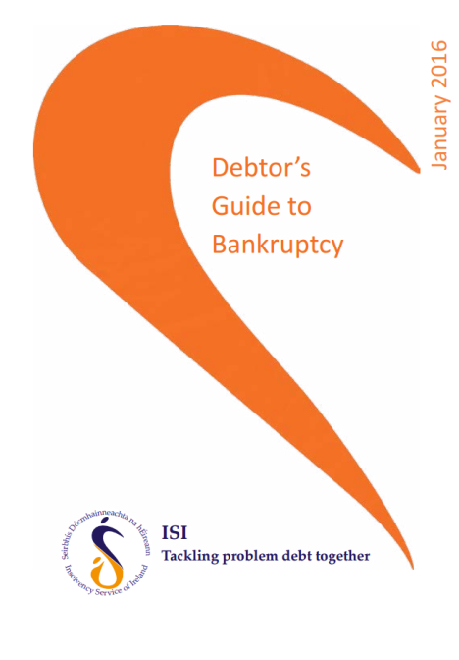
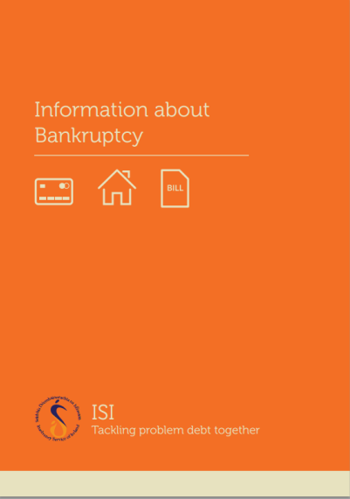
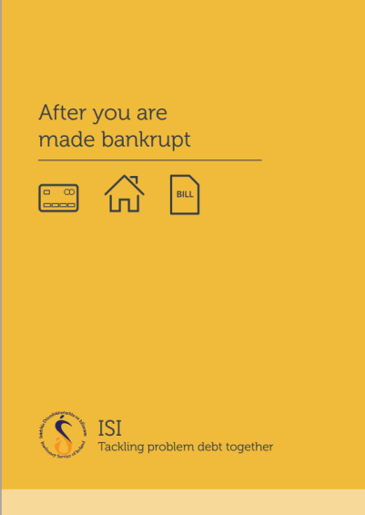
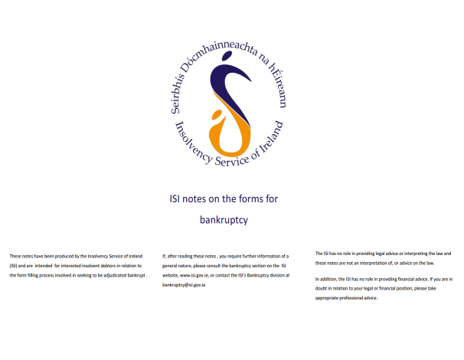
ISI Debtor’s Guide to Bankruptcy
Information about Bankruptcy
After you are made Bankrupt
Detailed Debtor’s Guide to Bankruptcy
ISI notes on the forms for Bankruptcy
See www.isi.gov.ie, Publications Section

Slide 8
Family Home
S 44 Bankruptcy Act – All property vests in OA on adjudication.
S 61(4) Bankruptcy Act - OA cannot dispose of interest in family home
without order of the High Court.
If the OA does not issue proceedings to sell, within 3 years of adjudication it shall revest in the bankrupt.
Jointly owned with spouse - joint tenancy split and OA
and spouse of bankrupt hold separate interests – Tenants in Common.
Equity in family Home - OA will always firstly seek to sell to bankrupt (using 3rd party funds) / spouse

Slide 9
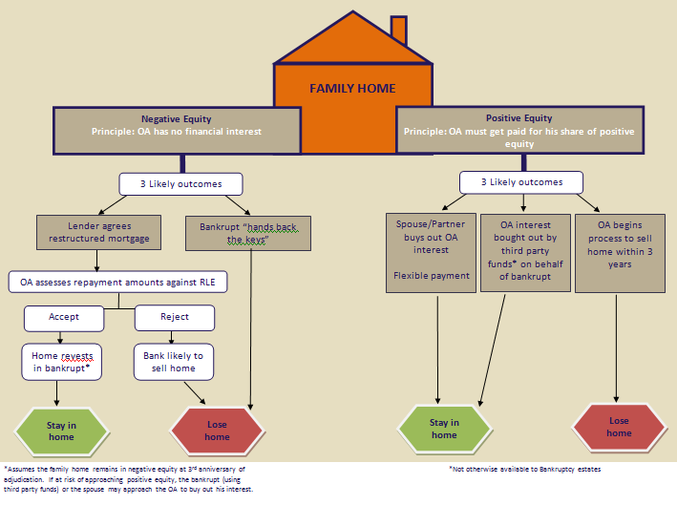
Family Home

Slide 10
Example 1 of Negative Equity family home retained
 | Assets (000s) | Liabilities (000s) | Total (000s)
Family Home | 350 | 550 | (200) | €1,500 Monthly repayment obligation
BTL | 200 | 430 | (230)
Other Debt |  | 70 | (70)
Total | 550 | 1,050 | (500)
Full mortgage serviced
Family home revests after 3 years
BTL sold, negative equity added to unsecured creditors' claim
IPO €500 for 3 years
Used to pay ISI fees and dividend to creditors (circa 5% return in this case)
Income | €4,000
RLE Set Costs | €2,000
Mortgage | €1,500
IPO | €500

Slide 11
Example 2 of Negative Equity family home
As before but income of only €3,000
No IPO as no surplus income
Family home could be retained if bank is willing to restructure to €1,000. Revests after 3 years
Family home will be lost if bank unwilling to restructure
Income | €3,000
RLE Set Costs | €2,000
Mortgage servicing capacity (Mortgage contractual obligation €1,500) | €1,000
Capacity for IPO | €0

Slide 12
Discharge
A bankrupt can apply to the High Court for a discharge from bankruptcy as follows:
1. Annulment
2. Once costs (of Official Assignee and the Petitioning Creditor), fees and preferential debts have been paid in full, and
- All creditors paid 100% or
- Creditors consent to discharge or
- A successful composition with creditors (by payment of a percentage dividend).
Otherwise the automatic discharge after 1 year applies
-Personal discharge after 1 year without Court order but assets stay vested in OA for realisation and distribution to creditors.
- Period can be extended by up to 15 yrs, if non co-operation with OA.

