Slide 1
Legal Aid Board: Solicitors Panel for Home Mortgage Arrears Scheme; Training Day Lorcan O’Connor, Director

Slide 2
ISI solutions - overview
Debt Relief Notice (DRN)
Immediate Relief
Supervision up to 3 Years
Debt < €35,000
No Voting
Debt Settlement Arrangement (DSA)
Immediate Relief
Protective Certificate duration:
70 days
Arrangement Duration:
0 – 5 Years
Unsecured settled
Voting:
65% Value
Personal Insolvency Arrangement (PIA)
Immediate Relief
Protective Certificate duration:
70 days
Arrangement duration:
0 – 6 Years
Secured settled and/or restructured &
Unsecured debts settled
Voting:
Secured 50% value,
Unsecured 50% value,
Total 65% value
(Appeal possible)
Bankruptcy
Immediate Relief
Duration:
1 Year; Income contribution up to 3 years
All debts settled
No Voting

Slide 3
ISI statutory Arrangements
Benefits of a Statutory Arrangement
Negotiated by experienced regulated professionals
Protection from creditors
No surprise changes
Peace of mind
Returned to solvency
Reasonable standard of living guaranteed
Sustainable
Popular criticisms of ISI arrangements
Creditors can veto any arrangement proposed
Your personal details will be available on public registers
Your credit rating will be damaged
PIPs cost money

Slide 4
Register in the ISI
ISI Offices

Slide 5
Benefits of a Statutory Arrangement
Improved credit ratings
James Treacy, CEO Stubbs Gazette has said that
“ we have recently reengineered our own consumer credit scores...so if a debtor enters into a Personal Insolvency Agreement or a Debt Settlement Arrangement and makes all of their payments on time, after 24 months their credit score will begin to repair. Their score will continue to improve over the next 3 to 4 years until at the very end of the arrangement their credit score will have been rehabilitated entirely.”

Slide 6
Cost of USING PIP Services
PIPs provide a professional service and so may charge a consultation fee. Although some PIPs do provide this service for free
Most of the PIP fees are usually built into the arrangement repayment plan
ISI has waived its fees
Debtor Aid & Advice

Slide 7
Positive Quotes

Slide 8
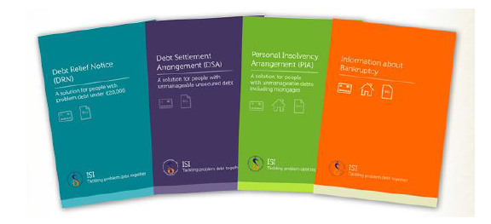
Thank you
www.backontrack.ie www.isi.gov.ie

