Slide 1
Legal Aid Board: Solicitors Panel for Abhaile; Training Day
Denis Ryan, Bankruptcy Division

Slide 2
Overview
Law Governing Bankruptcy
Official Assignee in Bankruptcy
Consequences of Bankruptcy
Self Adjudication Process
Family Home
Income Payment Orders
Discharge
PIA v Bankruptcy

Slide 3
LAW GOVERNING BANKRUPTCY IN IRELAND
Bankruptcy Acts 1988 – 2015
Civil Law (Misc. Provisions) Act 2011
Personal Insolvency Act 2012 – Part 4
Courts and Civil Law (Misc Provs) Act 2013 – Part 7
Companies (Misc Provs) Act 2013
Rules of the Superior Courts (Order 76 and Appendix 0) amended by SI 461/13, 600/14
ISI Regs – Accounts (SI 464/13 ); Fees (SI 465/13)
European Union Insolvency Regulation (EUIR)
- implemented in Ireland by S. I. No 334/2002
See www.isi.gov.ie, Legislation Section

Slide 4
Official assignee (OA)
An officer of the Court whose task is to:
1. Identify, recover and sell the bankrupt’s assets
2. Determine the extent of bankrupt’s liabilities and status of various debts
3. Distribute the proceeds amongst creditors by payment of a dividend
S44 - All property of a bankrupt vests in the Official Assignee from the date of adjudication and after acquired property equally vests in him, once he claims it.
S3 of Bankruptcy Act defines “property” – Definition as wide as could possibly be, per Supreme Court.

Slide 5
Summary of end to end process

Slide 6
CONSEQUENCES OF BANKRUPTCY
Loses ownership of assets
Must co-operate with OA and file Statement of Affairs
Prior Disposals can be voided. (S 57,58 and 59)
Cannot obtain credit >€650 without disclosing bankruptcy status
Cannot act as a company director, etc.
Can be examined before Court (S 21)

Slide 7
CONSEQUENCES OF BANKRUPTCY
Court can make Bankruptcy Payment Order (BPO) or bankrupt can agree Income Payment Agreement (IPA) with OA. Covers any surplus income after reasonable living expenses (ISI Guidelines). 3 years extendable to 5 years.
Must disclose property acquired after bankruptcy
Can trade, but only in name under which (s)he was adjudicated bankrupt
Can have bank account, matter for financial Institutions
Must inform OA of address change
Can be prosecuted (concealing property, absconding)

Slide 8
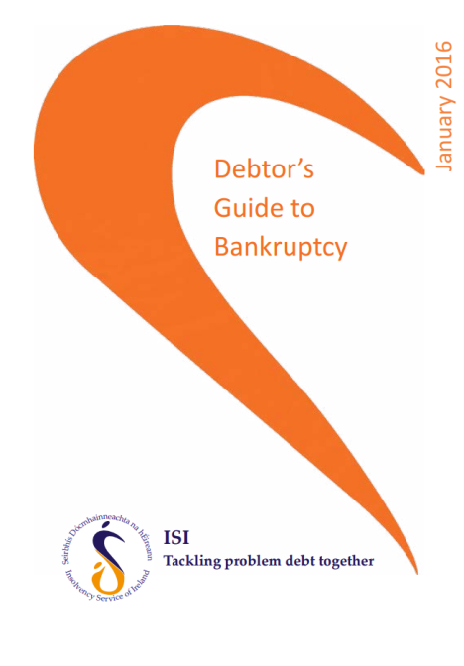
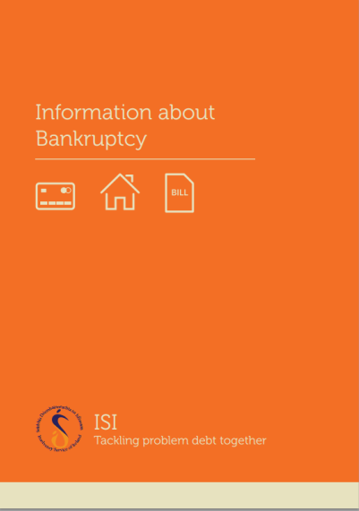
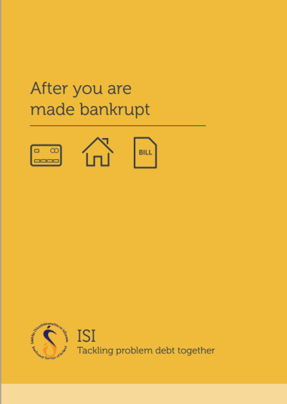
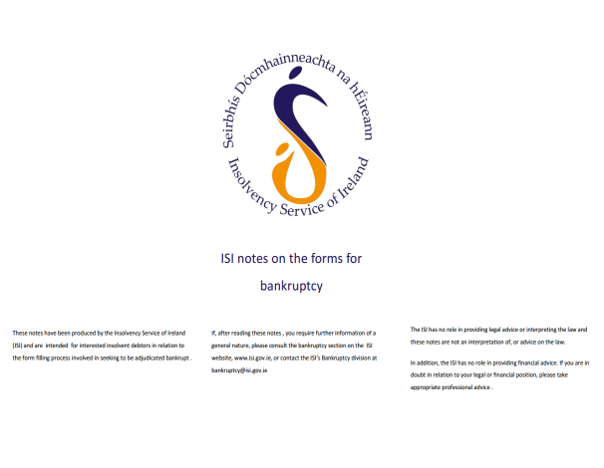
ISI Debtor’s Guide to Bankruptcy – Self adjudication process
Information about Bankruptcy
After you are made Bankrupt
Detailed Debtor’s Guide to Bankruptcy
ISI notes on the forms for Bankruptcy
See www.isi.gov.ie, Publications Section

Slide 9
Family Home
S 44 Bankruptcy Act – All property vests in OA on adjudication.
S 61(4) Bankruptcy Act - OA cannot dispose of interest in family home
without order of the High Court.
If the OA does not issue proceedings to sell, within 3 years of adjudication it shall re-vest in the bankrupt.
Jointly owned with spouse - joint tenancy split and OA
and spouse of bankrupt hold separate interests – Tenants in Common.
Equity in family Home - OA will always firstly seek to sell to bankrupt (using 3rd party funds) / spouse

Slide 10
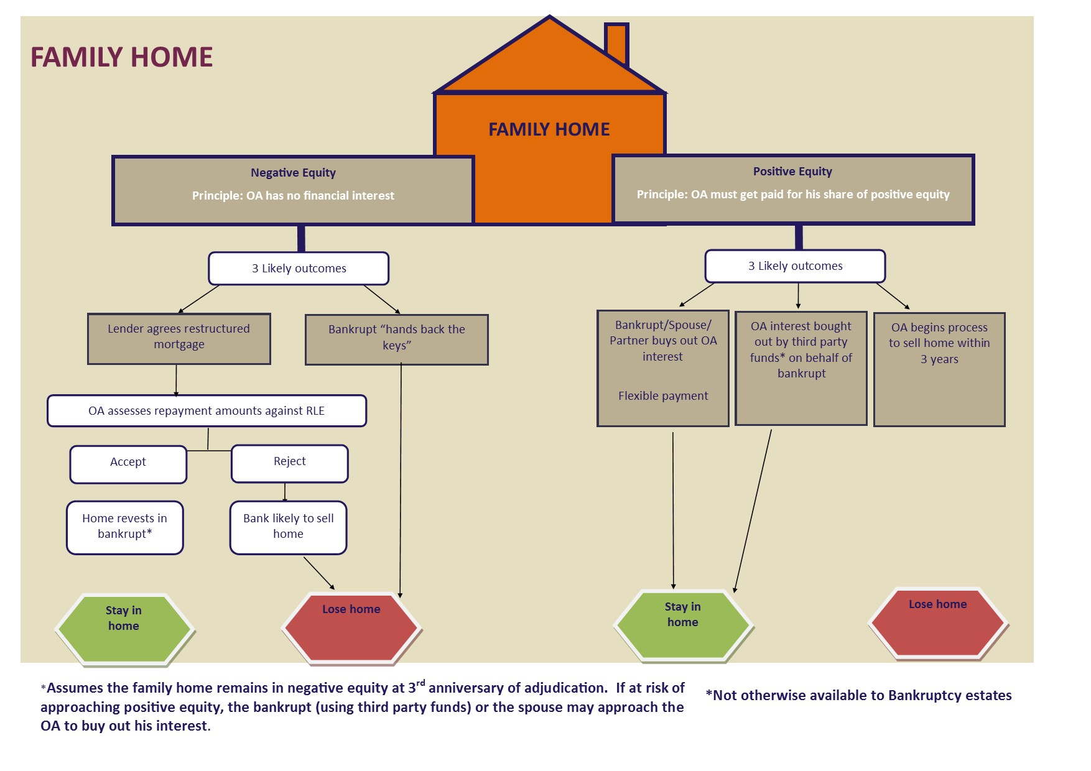
Family Home

Slide 11
Example 1 of Negative Equity family home retained
 | Assets (€000s) | Liabilities (€000s) | Total (€000s)
Family Home | 350 | 550 | (200) | €1,500 Monthly repayment obligation
BTL | 200 | 430 | (230)
Other Debt |  | 70 | (70)
Total | 550 | 1,050 | (500)
Full mortgage serviced
Family home revests after 3 years
BTL sold, negative equity added to unsecured creditors' claim
IPO €500 for 3 years
Used to pay ISI fees and dividend to creditors (circa 3% return in this case)
Income | €4,000
RLE Set Costs | €2,000
Mortgage | €1,500
IPO | €500

Slide 12
Example 2 of Negative Equity family home
As before but income of only €3,000
No IPO as no surplus income
Family home could be retained if bank is willing to restructure to €1,000. Re-vests after 3 years
Family home will be lost if bank unwilling to restructure
Income | €3,000
RLE Set Costs | €2,000
Mortgage servicing capacity (Mortgage contractual obligation €1,500) | €1,000
Capacity for IPO | €0

Slide 13
Discharge
A bankrupt can apply to the High Court for a discharge from bankruptcy as follows:
1. Annulment
2. Once costs (of Official Assignee and the Petitioning Creditor), fees and preferential debts have been paid in full, and
- All creditors paid 100% or
- Creditors consent to discharge or
- A successful composition with creditors (by payment of a percentage dividend).
Otherwise the automatic discharge after 1 year applies
-Personal discharge after 1 year without Court order but assets stay vested in OA for realisation and distribution to creditors.
- Period can be extended by up to 15 yrs, if non co-operation with OA.

Slide 14
PIA v Bankruptcy - Introduction
Estimated Outcome Statement
    Sales proceeds from assets & estimated income stream
    Estimated creditor dividend payable: PIA - v – Bankruptcy
Six Questions
    Why is a comparison required?
    What format should be used?
    What are the benefits of using an approved template?
    Are there any suggested assumptions to be applied?
    Are there any scenarios available?
    What are the common mistakes?

Slide 15
Q1: Why is a comparison required?
Legislative Requirement
    Section 71 (1)(d)(i) Personal Insolvency Act 2012 - DSA
    Section 107(1)(d)(i) Personal Insolvency Act 2012 - PIA
Commercial Negotiation
    PIP – present options to the creditors
    Creditor –aids voting decision making
    Debtor – clear understanding of the practical implications of both options - PIA and bankruptcy

Slide 16
Q2. What format should be used?
PIA Protocol
    Debt Solutions Protocol Steering & Working Group
    PIA Protocol first published in March 2015
        Stakeholders - Creditors, Debtors, PIPs/ISI
    Protocol Oversight Committee – template development
Estimated Outcome Statement Comparison Template
        Assumptions supporting calculations
        Computation tables: PIA /Bankruptcy Comparison & Bankruptcy Fee
        Template is recommended only / not a legislative requirement

Slide 17
Q3. What are the benefits of using an approved template?
Reduce the risk of:
        Creditor challenge (assuming PIA is otherwise protocol compliant)
        Contention in the event of a Court Review of a rejected PIA proposal

Slide 18
Q4. Are there any suggested assumptions to be applied?
Asset(s)
    A PIP should ensure that the value attached to an asset is reasonable
    Costs
        10% reduction in property market values can be applied – estate agents fees, legal fees, other costs
    Income
        Bankruptcy Payment Orders are for 3 years / PIA term may last longer
        Monthly income available for creditors is expected to be the same in both PIA and Bankruptcy (Potential variation: housing costs i.e. Mortgage –v- Rent)

Slide 19
Q5. Are there any scenarios available?
PIA Comparison with Bankruptcy: Scenario 9 & 10 (July 2016) - See www.isi.gov.ie for these detailed scenarios

Slide 20
Q6. What are the common mistakes made?
Review of Estimated Outcome Statement Computations (June 2015)
Incorrect Assumption | Correction
a. The OA will sell a property in negative equity on behalf of a secured creditor | a. The OA will disclaim the property and will not sell
b. The OA will sell “all assets” of the estate | b. A bankrupt can retain essential items valued at €6,000 (excepted articles)
c. The OA will award €6,000 to a bankrupt from the bankruptcy estate by way of priority distribution | c. The €6,000 excepted articles threshold refers to the valuation of assets owned on the day of adjudication that a bankrupt can retain rather than being an allowance that the bankrupt is entitled to
d. Income contributions are not payable by a bankrupt | d. The OA will assess a bankrupts income and apply RLE’s and seek a monthly contribution
e. ISI Fees are not applicable / calculated incorrectly | e. ISI fees apply to all cases, computation is prescribed by law and fees are paid in priority to a dividend

Slide 21
Conclusion
Reviewed:
    Law Governing Bankruptcy
    Official Assignee in Bankruptcy
    Consequence of Bankruptcy
    Self Adjudication Process
    Family Home
    Income Payment Orders
    Discharge
    PIA v Bankruptcy

Slide 22

Thank You

