Slide 1

Dedicated Mortgage Arrears (DMA) MABS
Annmarie O’Connor - Business Manager, MABS National Development Limited
Ciara Cullen – Relief Dedicated Mortgage Arrears Adviser, MABS National Development
30th May 2017
© MABS National Development Limited

Slide 2
Agenda
About MABS
Present Mortgage Arrears Situation
Background and Origins of Dedicated Mortgage Arrears Advice Service in MABS
A National Service – delivered from key locations
The role of the Dedicated Mortgage Arrears Advisors
What is a DMA Case ?
Lender Protocol
Added value
9. DMA Perspective – Ciara Cullen

Slide 3
Money Advice and Budgeting Service (MABS)
25 years experience dealing with all kinds of people & all kinds of debt.
Free, independent and confidential – “honest broker’’ between borrower and lender
The face-to-face service MABS money advisers provide, available from over 65 locations & MABS Helpline, Monday to Friday 9 am to 8pm (just over 20,000 calls in 2016)
University of Ulster – Advanced Diploma in Money Advice & Accredited Personal Insolvency Law Modules’ – ‘Approved Intermediaries’ (DRN) under Personal Insolvency legislation.
EFQM – Gold Star award – a quality mark for customer service excellence
Experienced, skilled and qualified staff

Slide 4
MABS & Mortgage Arrears
A key source of help for people with money management & debt difficulties.
A well developed process – ‘the money advice process’ which is a step by step approach - helping clients get back to a position of financial sustainability / self reliance.
Work with all the major creditor groups – debt resolution & debt management protocols with the major creditor groups (individual banks) BPFI, utilities, others
Very strong referral network both locally and nationally - CIS, SVP, local authorities, credit unions, FLAC and CLM – regulators, Govt. Departments and Agencies, FSO, other agencies /NGOs
Every MABS Money Adviser has helped clients in mortgage arrears and all are familiar with the CCMA, the MARP and the MARP SFS – focus is on making an arrangement where this is possible

Slide 5
Q4 - 2016 Central Bank Mortgage Arrears Statistics
A total of 77,493 (11 per cent) of accounts were in arrears at end-Q4
33,447 mortgages in arrears of 720 days and over
Statistics are startling
Far more concerning is that each of these statistics represents a homeowner / household in real hardship – confronting difficult choices and worrying about keeping their home

Slide 6
Background – enhanced role for MABS
Government announcement May 2015 – ‘greater role for MABS’ viz. ‘the Money Advice and Budgeting Service (MABS) will play a greater role in offering information, advice and assistance to borrowers in arrears.
New Dedicated Mortgage Arrears (DMA) Advisors at locations nationwide
Roll-out of a Court Mentor Scheme to support clients attending repossession proceedings – the State’s Services – ISI & MABS
MABS / MABS Helpline as the Gateway to Debt Advice – (Free Legal Aid and Financial Advice – Voucher scheme (announced January 2016) operational July 2016)
Programme for Govt. 2016 ‘a new national service to standardise the supports available to borrowers in mortgage arrears, with powers and resources needed to advise, assess, negotiate and recommend solutions’ (ABHAILE)

Slide 7
DMA Locations - nationwide coverage from key locations
Arklow MABS
Bray MABS
Carlow MABS
Cavan MABS
Cork MABS
Kerry MABS
Kildare MABS
Leitrim MABS
Laois MABS
Limerick MABS
Longford MABS
North Donegal MABS
North Tipperary MABS
Meath MABS
Monaghan MABS
North Galway MABS
South Galway MABS
South Mayo MABS
South Tipperary MABS
Waterford MABS
Sligo MABS
DUBLIN
  Dundrum MABS
  Fingal MABS
  Finglas/Cabra MABS
  Tallaght MABS

Slide 8
What makes it a DMA case?
  Mortgage Deemed Unsustainable
  Client Deemed Not Cooperating
  Not offered an Alternative Repayment Arrangement by their lender
  Entered into an Alternative Repayment Arrangement (ARA) but has failed to meet the repayments as agreed
  Clients who want to explore insolvency (refer on to a PIP for section 52 advice )
  Clients who are at any stage of the Pre-Legal or Legal process
  Complex cases, for example,
    vulnerable clients, separation cases, multi-banked clients, self-employed, illness etc.
Not in scope for DMA - Pre-arrears, Early arrears (<3m) cases

Slide 9
Client Profile DMA (cases only)
Data based on circa 2,800 DMA clients

Slide 10
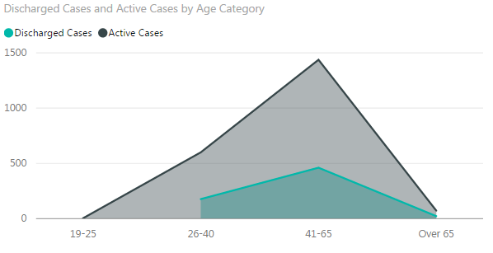
DMA Caseload By Age Category
72% of DMA clients are aged 41+
Age is a significant factor :
When seeking term extensions
In addressing arrears within contractual term
When considering long term income prospects

Slide 11
DMA Caseload – Family Status
Married People represent 49.7% of DMA cases (Census 2011 47.4%)
Single People represent 16.4% of DMA cases (Census 2011 41.7%)
Separated/Divorced/Widowed People represent 31.6% of DMA cases (Census 2011 11.0%)
Single/separated households present particular difficulties:
  Insufficient income to meet mortgage
  Mortgage more readily deemed unsustainable by lenders
  Non co-operating former partner and the barriers to progressing solutions

Slide 12
DMA Caseload- Income Status
47% of DMA cases are self employed or working (57% Census 2011)
20% are in receipt of Disability Payments (5% Census 2011)
21% in receipt of Unemployment Benefits
3% receive Retirement Pensions (14% Census 2011)
Higher proportions of DMA cases are in receipt of welfare payments
A particular feature of DMA cases is the high percentage where these welfare payments are long term, e.g. disability benefits

Slide 13
Court Mentor
Some MABS staff started attending Court in late 2014– as a response to the needs of clients – at that time only in certain Courts on the basis of discussion and agreement with Courts & Registrar
Joint MABS/ISI pilot in July 2015 - MABS advice staff now attend all possession hearings nationwide – there is usually (space permitting) a MABS stand in Court
A friendly face who understands what's going on
Court Mentor is a point of referral to MABS /ABHAILE Services
Further development on foot of new Scheme – Duty Solicitor
Awareness of boundaries - MABS cannot represent clients in Court, we can only support
Fast tracking cases depending on the Court dates (i.e. if a client is due back in Court)
  Low numbers of borrowers attend Court but of those that do - there are many now going to MABS to address their difficulties
Notes:
Court Mentor and DMA are separate roles.

Slide 14
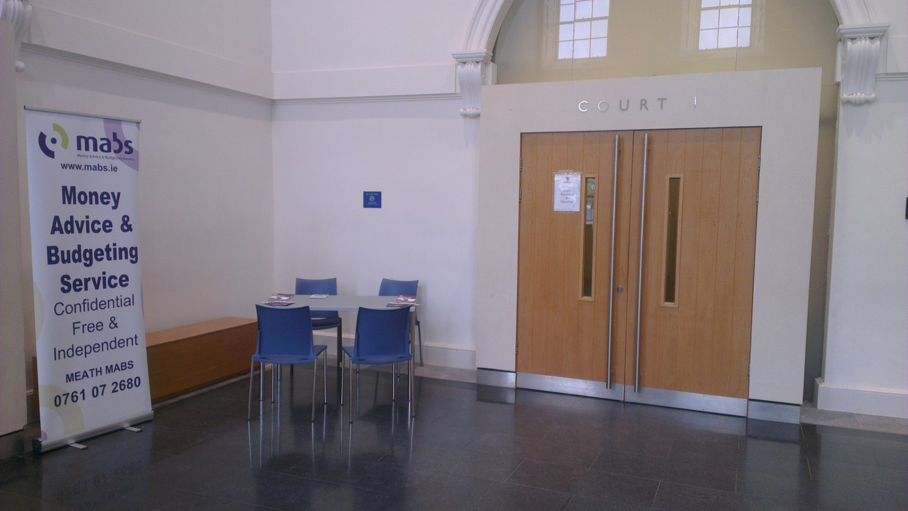
Court Mentor - Trim (Meath MABS)

Slide 15
MABS - Lender Protocol
  High level requirements from MABS:
    Priority for MABS clients
    Specific timelines for correspondence between MABS and lenders (no delays)
    A named contact within an Arrears Support Unit
    Access to a decision-maker / face -to-face where necessary to discuss a case
    Stay on any further legal action while engaging with MABS – (UNLIKELY)
    Freeze any additional charges on the mortgage account
    Commitment to improve practices & outcomes from around specific cohort of borrowers e.g. separated couples, over 65s
    Regular meetings around process issues

Slide 16
Professionalism,
Compassion & Commitment
The Court Mentor was ever so helpful and professional in how she explained the court process and in the advice she gave us. She arranged vouchers for us and phoned on a number of occasions to see how we were getting on. On the day of our court appearance she could not have been more attentive and helpful to us, while at the same time supporting others whose cases were also before the County Registrar.
‘In a time of despair the MABS Money Adviser helped me – and by extension my young family- to overcome the obstacles that presented themselves. In direct contrast to the behaviour of the callous financial institutions her empathy, understanding and kindness should make
your organisation proud’
I was suicidal but something changed… MABS gave me a place to share my fear, my hopelessness….it gave me a structure, things to do when I could not think clearly. I put my trust in you and you delivered.

Slide 17
Does it make a difference?
Before engaging with MABS I was in denial of my financial situation, believing there was no hope. Not talking to anyone about it - family or friends.
I came across the following quote:
"Just when the caterpillar thought the world was over it became a butterfly."
That's how I'm feeling today, a butterfly. I have my life back again, no more sleepless nights
or fear of the post dropping through the letterbox (DMA client – case struck out )

Slide 18
DMA Perspective – Ciara Cullen
Money Adviser Dundrum/Rathfarnham MABS – March 2009
Approved Intermediary for Debt Relief Notices (DRNs) since May 2016
Dedicated Mortgage Arrears (DMA) Adviser since July 2016
Previously 60% cases with mortgage arrears, now 100%
Fewer cases – more in-depth analysis
Complex and urgent cases:
  Late stage mortgage arrears
  Usually outside of MARP – 75% of cases already in Court
  High levels of arrears
  Affordability & sustainability issues
  Separated couples, self-employed, pensioners, widowed, vulnerable clients
  Multiple properties, multiple debts

Slide 19
DMA Adviser Role in Practice
Full assessment for new MABS clients – holistic approach
Seek to maximise income – social welfare, tax credits, TRS, FIS, etc.
Redirect income to mortgage – priority debt
Complete SFS – send with proposal. Sometimes only seeking short-term Alternative Repayment Arrangement (ARA) until income / situation improves but most proposals based on long term repayment arrangements
Negotiate with lenders – very important. Is proposal more attractive than alternatives, e.g. bankruptcy? Better than what they might get in a Personal Insolvency Arrangement? Better than possession & sale?
Consider & prepare for ‘other options’ – MTR, surrender, voluntary sale, social housing. Proposals for dealing with residual debt.
Make referrals – PIPs, CAVA, FLAC… and now you!

Slide 20
Court Mentor – Dublin
  From 2016 – Court Mentor in all 28 County Registrar Courts nationwide
  2 Court sittings per week in Dublin – average 40-50 mortgage cases per sitting
  County Registrar may make reference to and introduce the Court Mentor at the beginning of each sitting.
  County Registrar may make direct referrals to MABS through the Court Mentor and allows the defendant time to engage with the Service
  Although no rights of audience, County Registrar may ask Court Mentor for an update on cases during Court
  Court Mentor introduces the MABS client to the Duty Solicitor before court and briefs the Duty Solicitor on the case. Where permitted by the County Registrar, the Duty Solicitor then briefs the Court.
  Duty Solicitor also available to advise defendants present in Court who have no representation or have never been to MABS
  More borrowers attending Court now – know that MABS / Duty Solicitor available for support – very empowering for the borrower

Slide 21
MABS Role in Respect of Access to Legal Advice (Consultation Solicitor)
MABS – completes MARP SFS with client
Determines client fits criteria for advice under scheme
Informs client about scheme, certifies eligibility and applies for voucher for client
Provides voucher and list of panel solicitors to client
Transfers MARP SFS with client’s consent to the solicitor
Continues to support client in accordance with their wishes

Slide 22
Where does Legal Advice come in?
75% of DMA cases already in Court
Legal Advice required:
  New contracts / ARAs / restructures offered by lenders
  Separated / divorced couples
  Land law issues – rights of way, easements (water, etc.), planning permission issues, mapping issues, incorrect mortgage / charge registration. Some may reduce value of property & make ARA proposal more attractive to lender than possession & sale
  Technical issues – non-service of Civil Bill, inaccuracies
  Circuit Court Jurisdiction & ‘Rateable Valuation’: Permanent TSB –v- David Langan referred by Case Stated to Court of Appeal
  Bankruptcy advice & assistance

Slide 23
Outcomes from the DMA Service
John and Teresa, both late 60s, family home (PPR), arrears of €60k, total outstanding - almost €214k, 11 years remaining, paying €600 per month
Mortgage deemed unsustainable in 2012; PIP proposal rejected
High Court proceedings initiated in 2015; Judge adjourned the case in Feb 2015 as there was no evidence of alternative options present to the clients
Order for Possession granted in November 2015 with a stay until 1st Feb 2016
Legal Aid Board lodged an appeal on behalf of the clients
DMA MABS adviser suggested making a settlement offer to the lender. Clients contacted local Credit Union and got approval in principal for a loan of €50,000 based on affordability to pay €600 per month over 10 years.
Full & final settlement offer of €50k made to lender based on client’s ages and current market value of the property which was significantly reduced due to sceptic tank and boundary issues.
Settlement offer accepted, Credit Union loan drawn down in October 2016 and deeds of property released by the lender in November 2016.

Slide 24
Outcomes from the DMA Service
Tracy (35) is a single parent with 2 children, she got into mortgage arrears following separation from her husband.
Legal proceedings were in the advanced stage and client was referred to MABS in the Registrar’s Court.
Balance on the mortgage was €185k, arrears of €23k (originally borrowed €179k in 2005)
SFS completed and proposal of €600 per month offered. Secondary debt owing to the Credit Union restructured.
Lender offered a Split Mortgage with repayments of €528 per month. Arrears capitalised and 25% of mortgage debt warehoused for 30 years
Client completed a 6 month trial repayment period and long term arrangement subsequently put in place
Case struck out of Court in January 2017 – no costs
Client intends to trade down when her children finish education

Slide 25
Outcomes from the DMA Service
Fiona and Declan, 3 children, referred to MABS by Co. Registrar
Mortgage balance €221k, arrears €39k, property value €90k, no payments made in 2 years
SFS completed, max affordability of €300 pm, repayment due €930 pm
Borrowers in receipt of Disability Allowance & Invalidity Pension, very little prospects of improving financial circumstances
Consultation with a PIP – insufficient income for a PIA
Mortgage to Rent explored – satisfied all eligibility criteria but no Approved Housing Body expressed an interest in buying the property
Clients have accepted the mortgage is unsustainable and have applied for Local Authority housing
Lender has agreed to a 9 month stay and will not pursue any residual debt if borrowers consent to Order for Possession on the next Court date

Slide 26
How do you measure success?
Client Engagement – some clients coming to MABS after 5 years of hoping the problem would go away
Sustainable arrangements – everyone has to be realistic
Credible independent legal advice on relevant issues
Insolvency arrangements
Mortgage to Rent – if possible – it’s a very good solution when it happens
Where home must be sold – minimising residual debt
Where home must be sold – preventing homelessness
Unfortunately there has been a lot of misinformation and some bad third party advice and not every situation will have a positive outcome for the client
Huge potential benefit in ABHAILE in ensuring that there is full support for borrowers

Slide 27
Conclusion
MABS is the ‘Gateway to Debt Advice’ contact MABS Helpline 0761 07 2000
The DMA MABS is a new, added-value, free service available from MABS
If you can’t talk to your lender – talk to MABS – we’ll help & refer you to professional advice under ABHAILE when you need it
Cases are difficult but solutions can be found

Slide 28
